Slide 1

Learning interpretable reduced-order models for jumping quadrupeds
Master’s thesis by Gioele Buriani
Supervisor: Cosimo Della Santina
Co-supervisor: Jingyue Liu

Slide 2
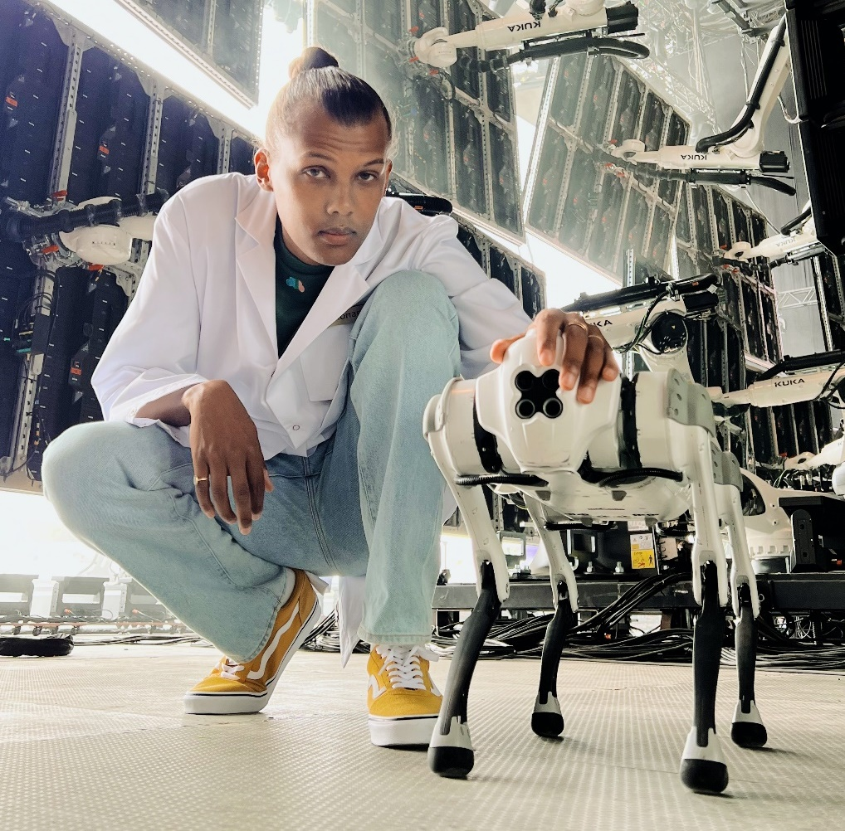
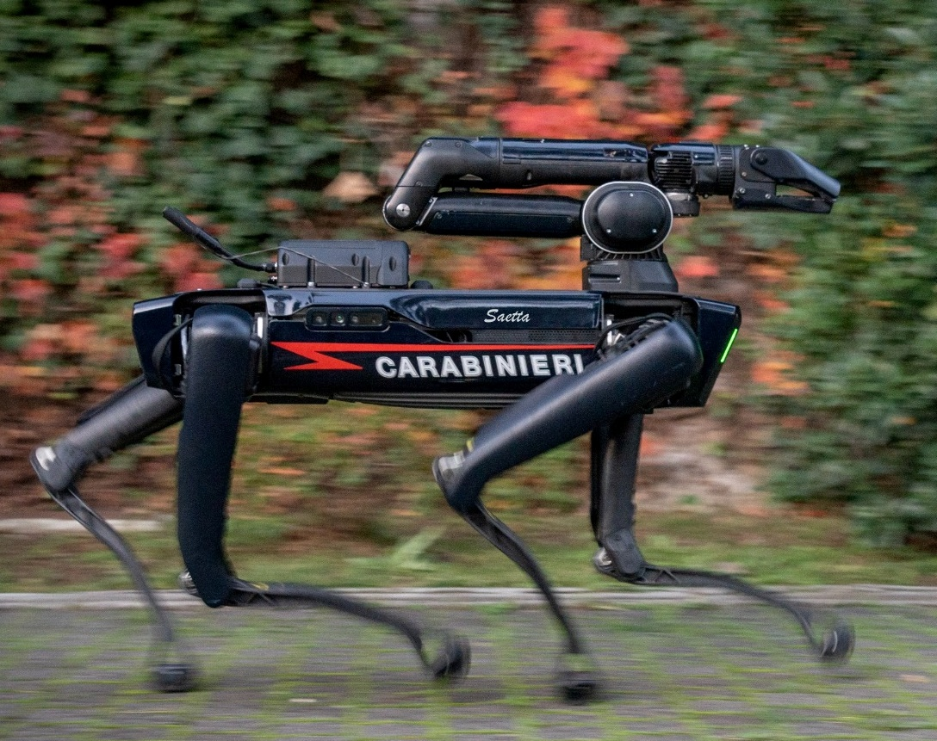
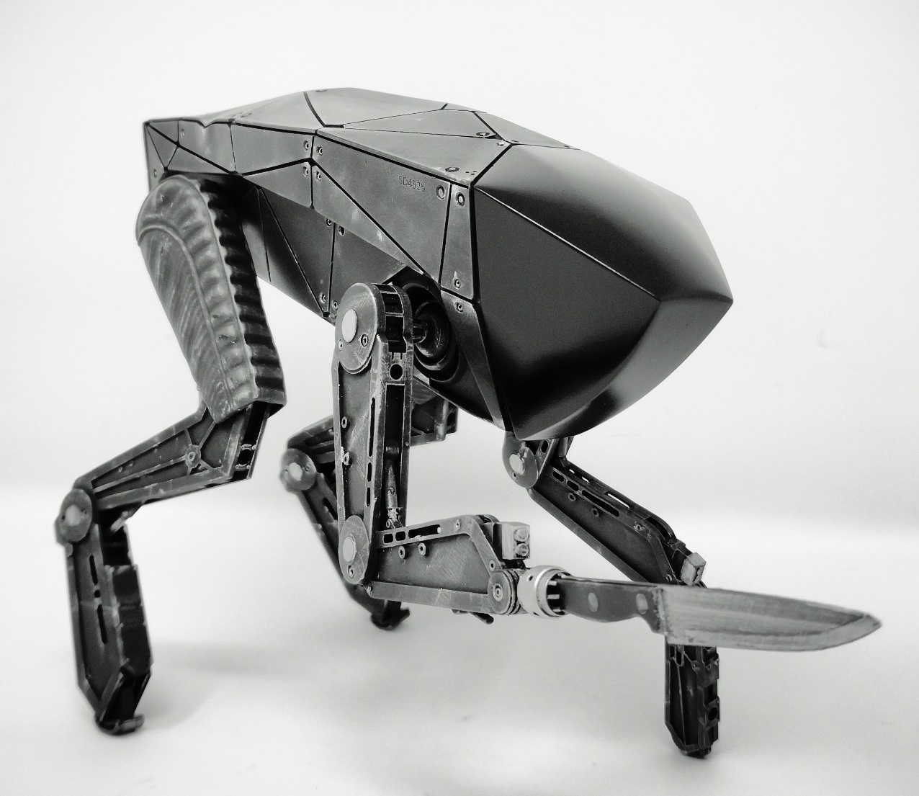
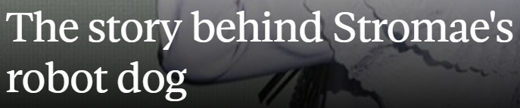


Slide 3
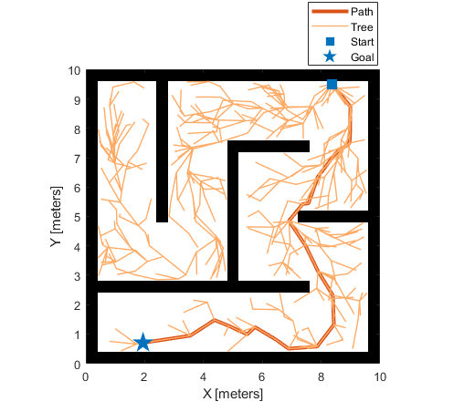
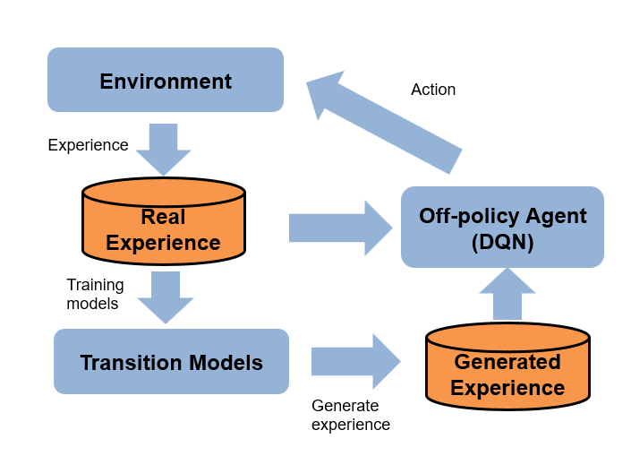
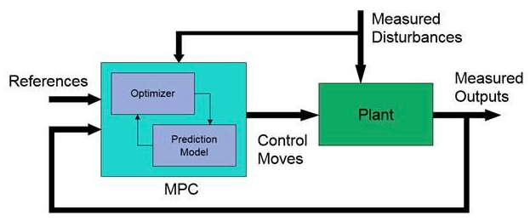
Motion planning
Control algorithms
MODEL
Notes:
Optimization based vs machine learning based

Slide 4
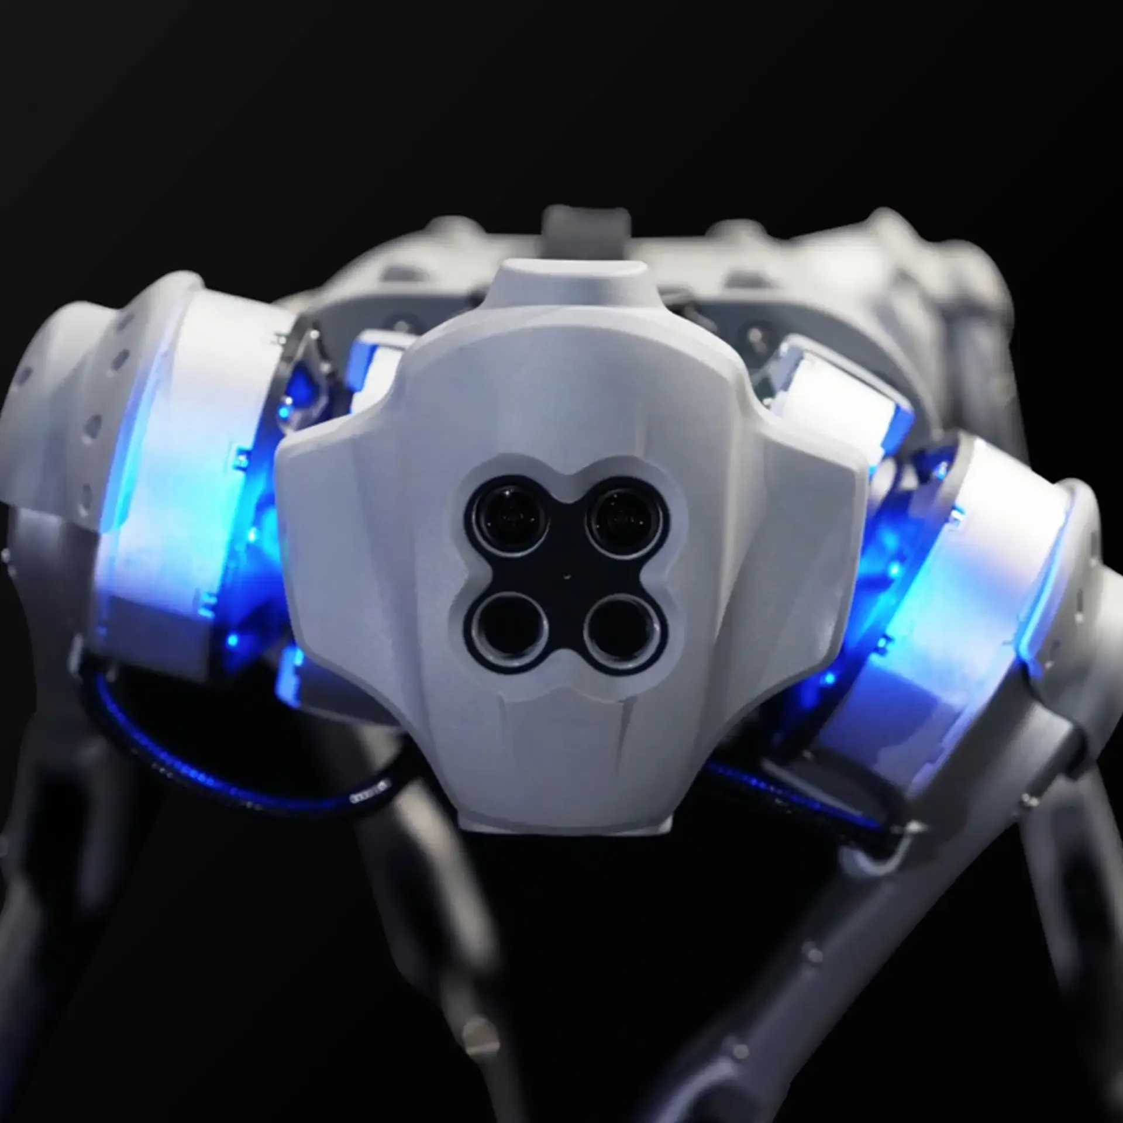
Outline
Motivation
Methodology
Results
Discussion

Slide 5
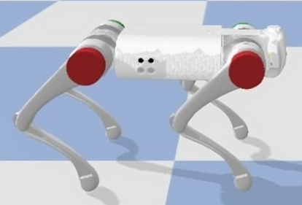
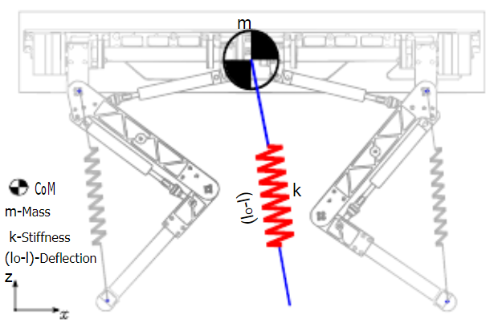
FULL-ORDER MODEL
(18 dim)
TEMPLATE MODEL
(2 dim)
Pros - Contains all the information of the system
Cons - Difficult to calculate «by hand» - Hard to handle (high dimension)
Pros - Simple to handle
Cons - Ignores some dynamics of the system
Motivation
Methodology
Results
Discussion

Slide 6

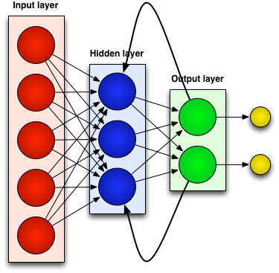
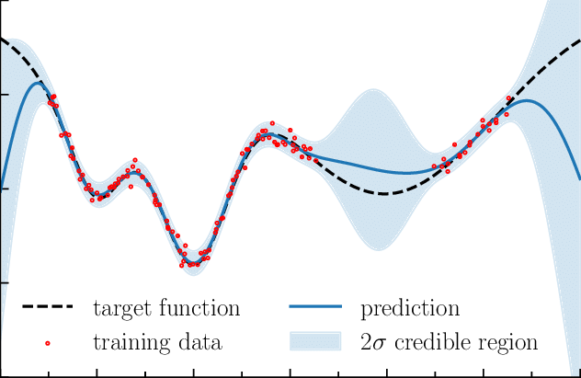
Model Learning
Recurrent Neural networks
Gaussian processes
REDUCED-ORDER
MODEL
REDUCED-ORDER
MODEL
reduced-order
models
Interpretability
Interpretable
Motivation
Methodology
Results
Discussion
Notes:
A Gaussian Process model's output consists of a probabilistic distribution over functions, characterized by a mean function that predicts the expected output for any given input and a covariance function that quantifies the prediction uncertainty,

Slide 7
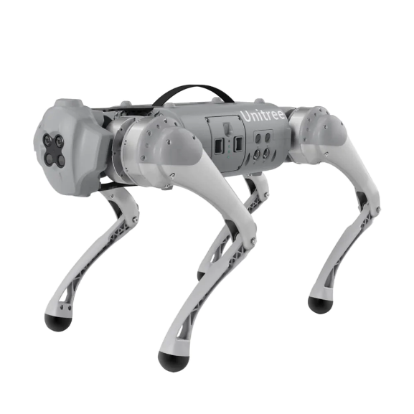

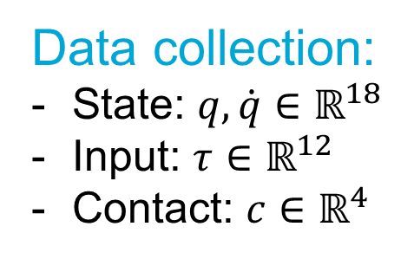
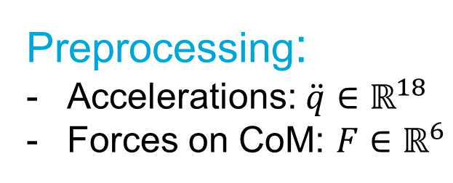
Methodology – Data collection
Data collection:
State: $q,\dot{q}∈ℝ^{18}$
Input: $τ∈ℝ^{12}$
Contact: $c∈ℝ^{4}$
Preprocessing:
Accelerations: $\ddot{q}∈ℝ^{18}$
Forces on CoM: $F∈ℝ^{6}$
Contact phase and flight phase
Motivation
Methodology
Results
Discussion

Slide 8
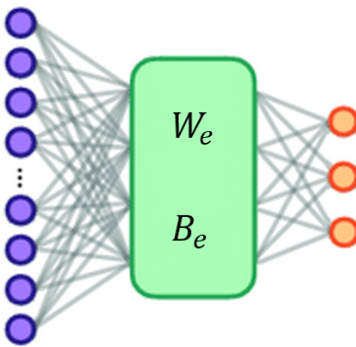
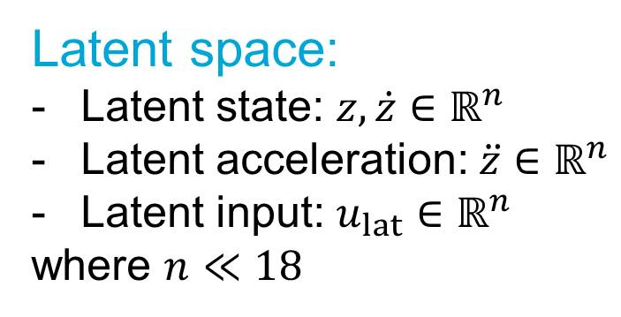
Methodology - Encoding
Latent space:
Latent state: $z,\dot{z}∈ℝ^{n}$
Latent acceleration: $\ddot{z}∈ℝ^{n}$
Latent input: $u_{lat}∈ℝ^{n}$
where $n≪18$
Linear autoencoder
Motivation
Methodology
Results
Discussion

Slide 9
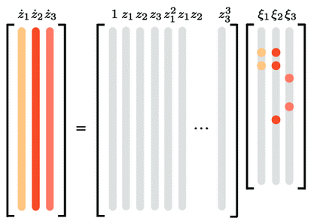
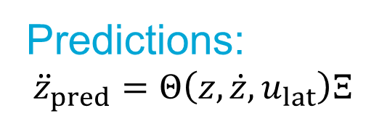
Methodology – Symbolic regression
Predictions:
$${\ddot{z}}_{pred}=Θ\left(z,\dot{z},u_{lat}\right)Ξ$$
Joint training between autoencoder and SINDy
Data-driven discovery of coordinates and governing equations
K Champion, B Lusch, JN Kutz, SL Brunton
Motivation
Methodology
Results
Discussion

Slide 10
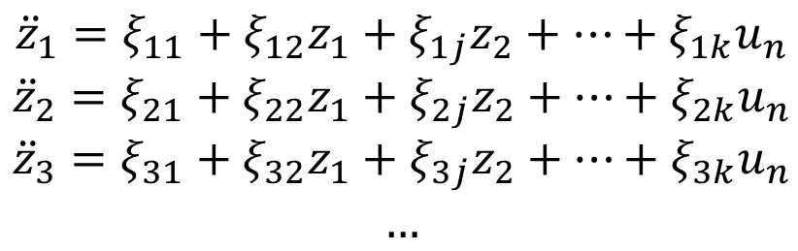
Methodology – Final model
$${\ddot{z}}_{1}=ξ_{11}+ξ_{12}z_{1}+ξ_{1j}z_{2}+…+ξ_{1k}u_{n}$$
$${\ddot{z}}_{2}=ξ_{21}+ξ_{22}z_{1}+ξ_{2j}z_{2}+…+ξ_{2k}u_{n}$$
$${\ddot{z}}_{3}=ξ_{31}+ξ_{32}z_{1}+ξ_{3j}z_{2}+…+ξ_{3k}u_{n}$$
$$…$$
Interpretable reduced-order dynamic model as a set of differential equations
Motivation
Methodology
Results
Discussion

Slide 11
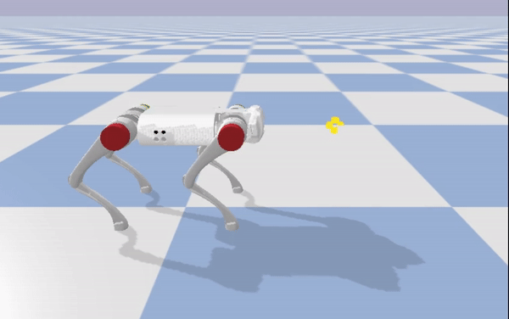
Results – Go1 Simulation
Motivation
Methodology
Results
Discussion

Slide 12
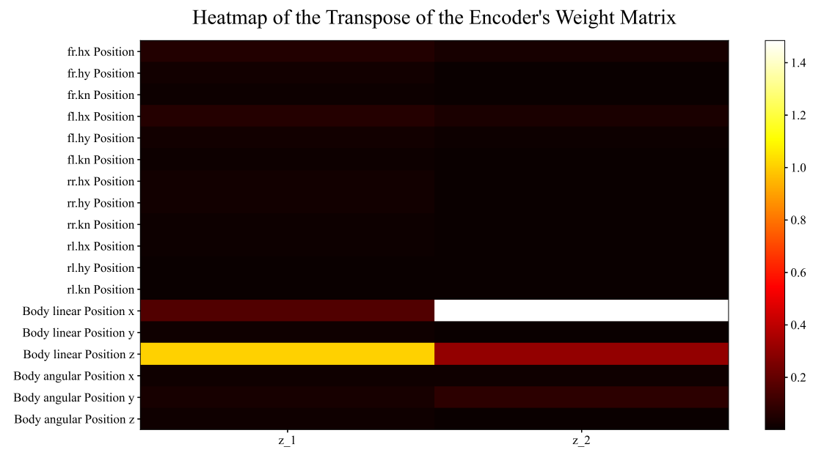
Results – 2D model
Motivation
Methodology
Results
Discussion

Slide 13
Motivation
Methodology
Results
Discussion

Slide 14
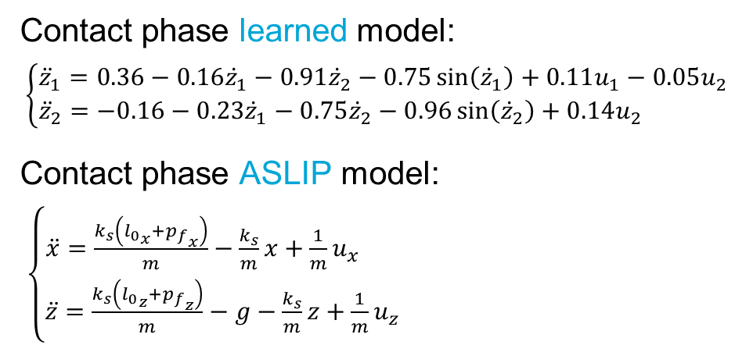
Results – 2D model
Contact phase learned model:
$\left\{\begin{aligned}{\ddot{z}}_{1}=0.36−0.16{\dot{z}}_{1}−0.91{\dot{z}}_{2}−0.75\sin\left({\dot{z}}_{1}\right)+0.11u_{1}−0.05u_{2}⁡ \\ {\ddot{z}}_{2}=−0.16−0.23{\dot{z}}_{1}−0.75{\dot{z}}_{2}−0.96\sin\left({\dot{z}}_{2}\right)+0.14u_{2} \end{aligned}\right.$
Contact phase ASLIP model:
$\left\{\begin{aligned}\ddot{x}=\frac{k_{s}\left({l_{0}}_{x}+{p_{f}}_{x}\right)}{m}−\frac{k_{s}}{m}x+\frac{1}{m}u_{x} \\ \ddot{z}=\frac{k_{s}\left({l_{0}}_{z}+{p_{f}}_{z}\right)}{m}−g−\frac{k_{s}}{m}z+\frac{1}{m}u_{z}⁡\end{aligned}\right.$
Body linear position x and Body linear position z
are predominant
Motivation
Methodology
Results
Discussion

Slide 15
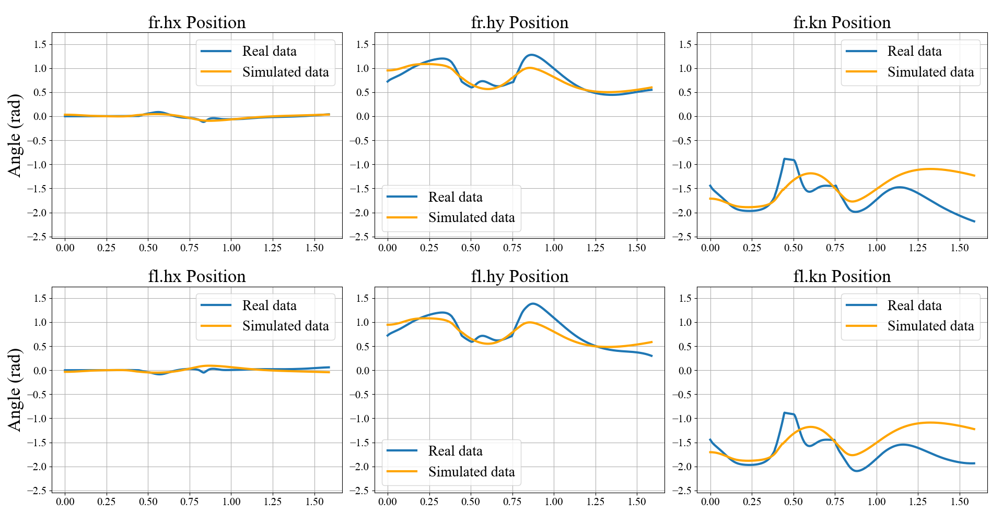
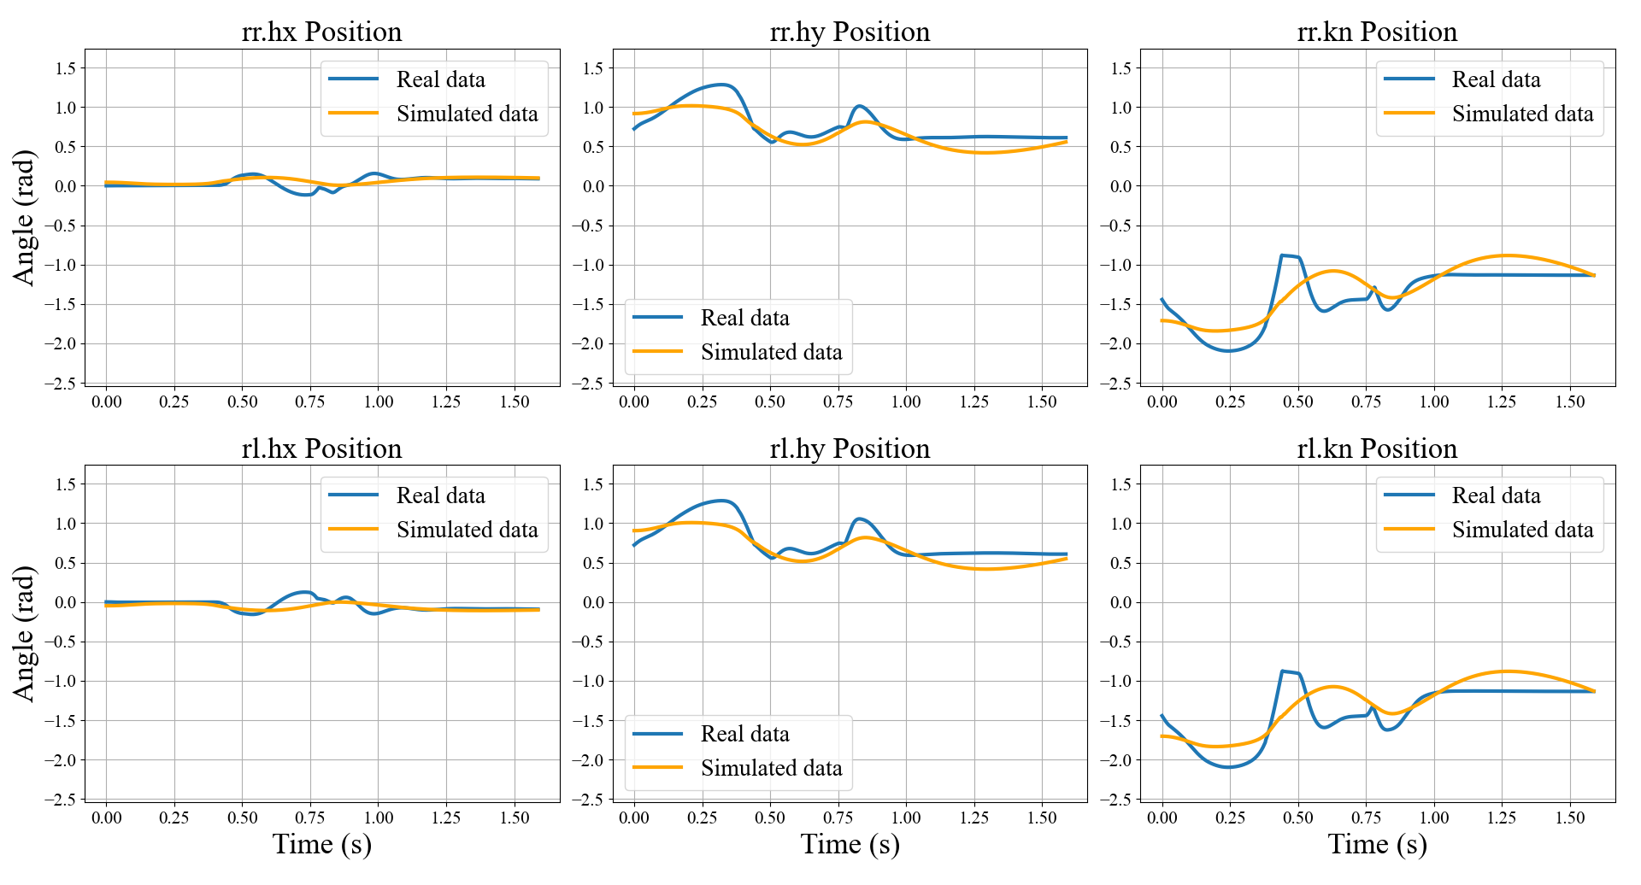
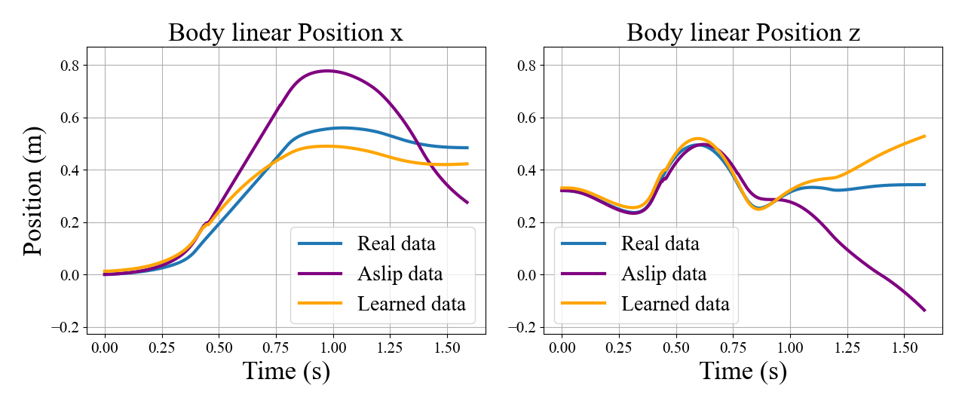
Results – 2D model
Motivation
Methodology
Results
Discussion

Slide 16
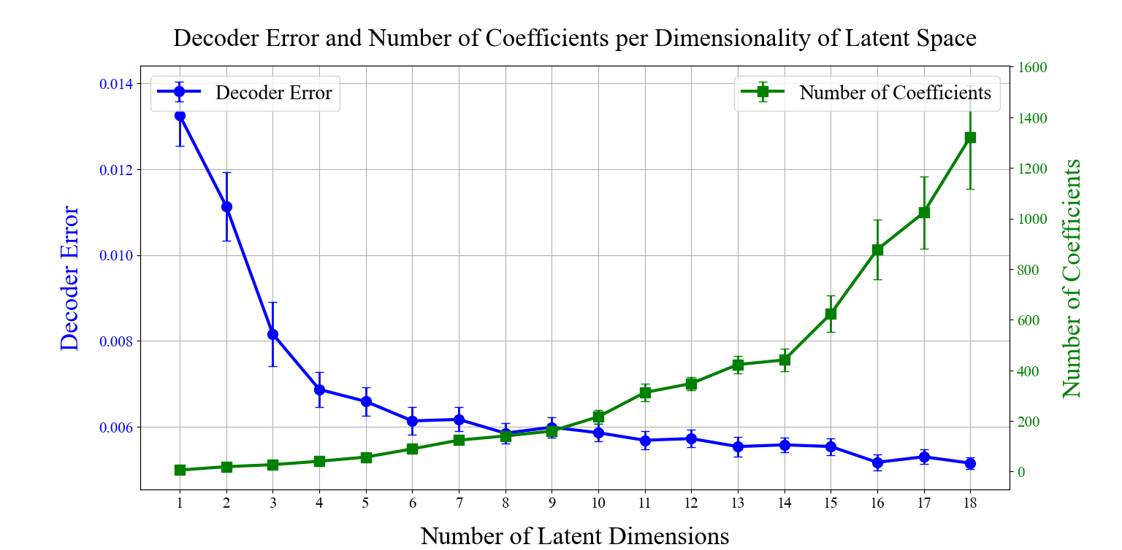
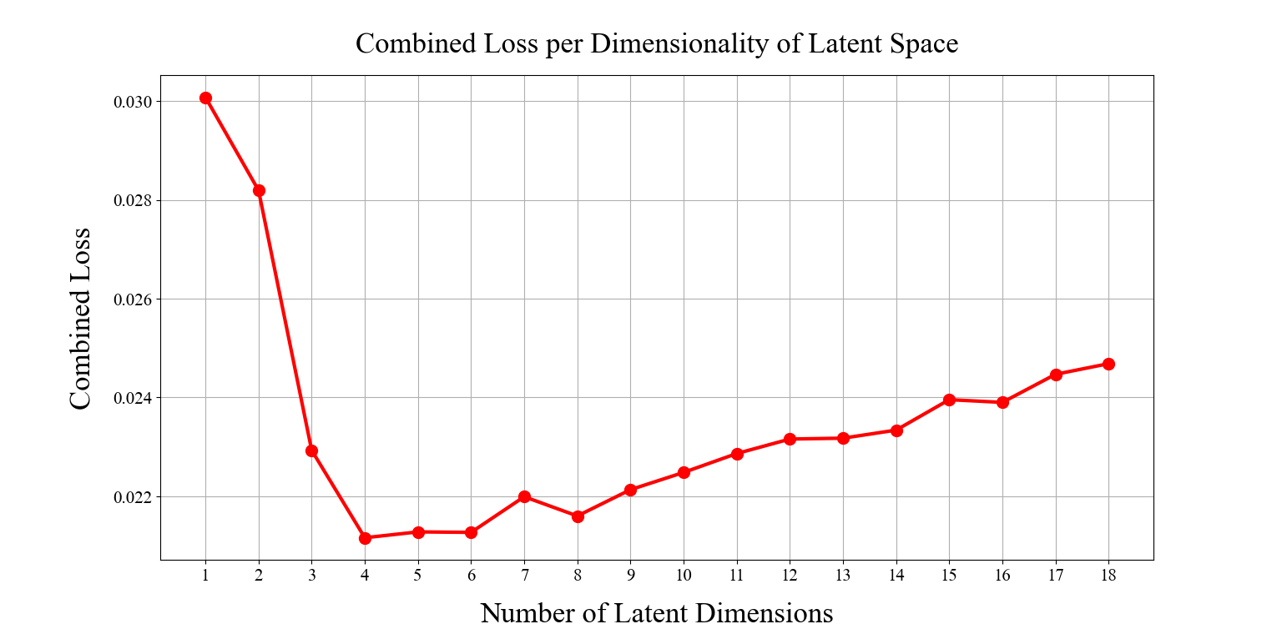
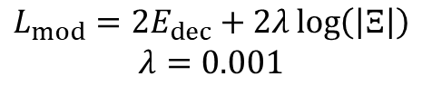
Results – Latent dimensionality analysis
$$L_{mod}=2E_{dec}+2λ\log\left(\left|Ξ\right|\right)$$
$$λ=0.001$$
Motivation
Methodology
Results
Discussion

Slide 17
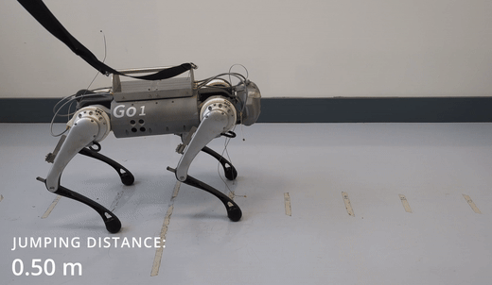
Results – Go1 Real
Motivation
Methodology
Results
Discussion

Slide 18
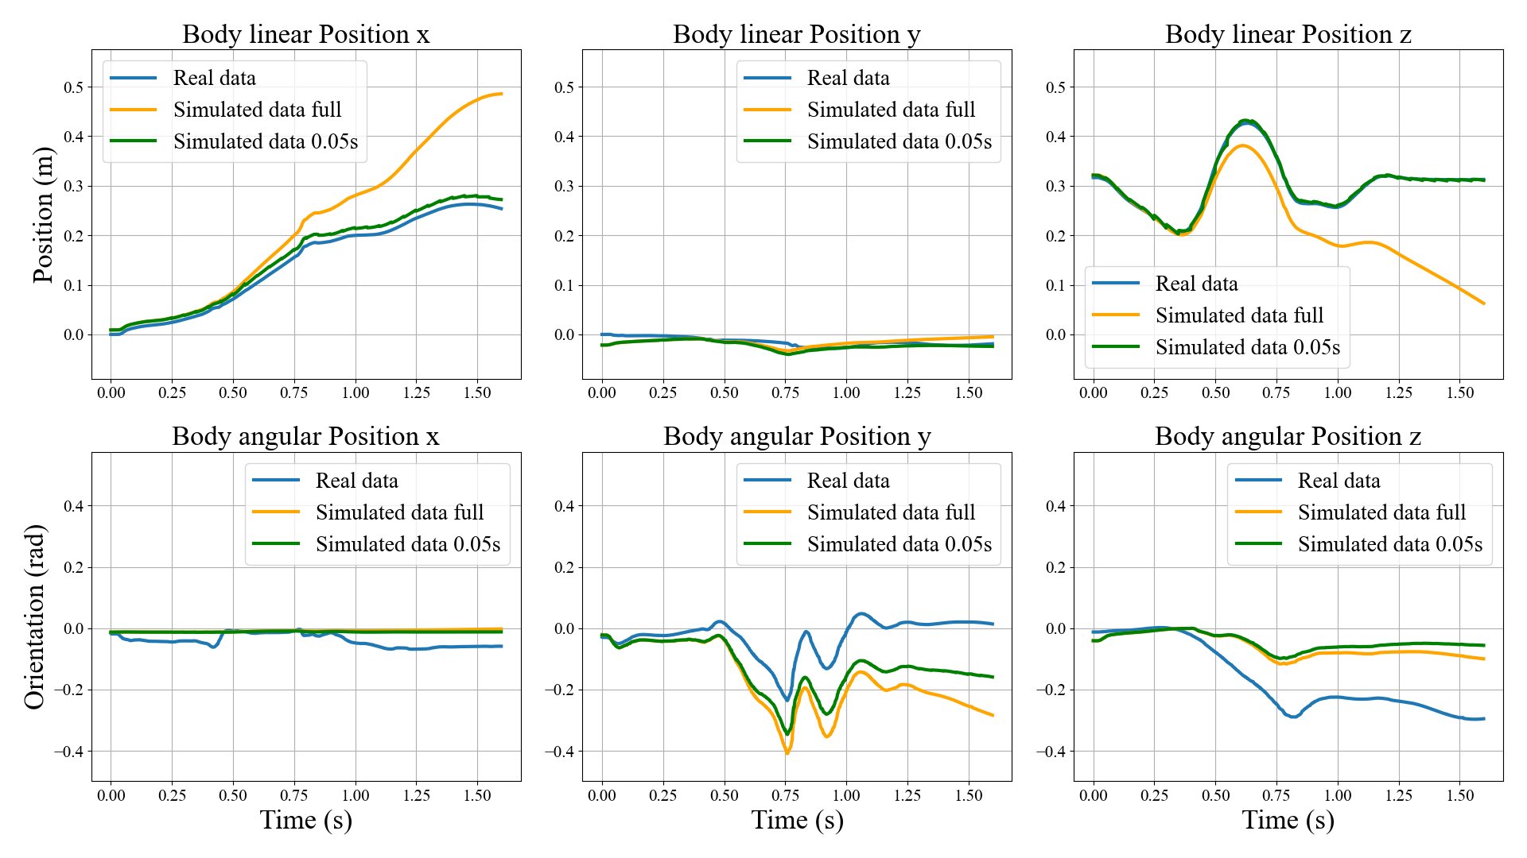
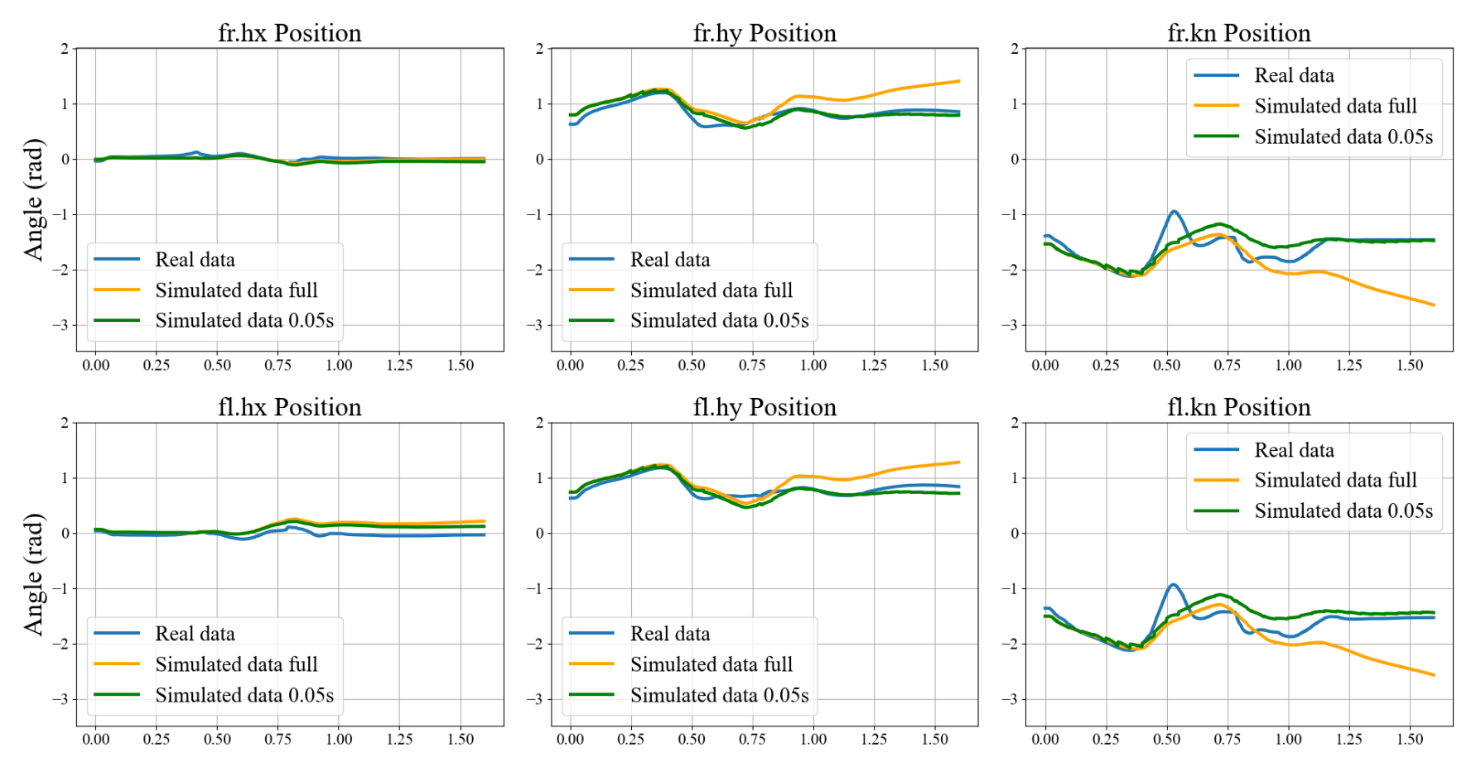
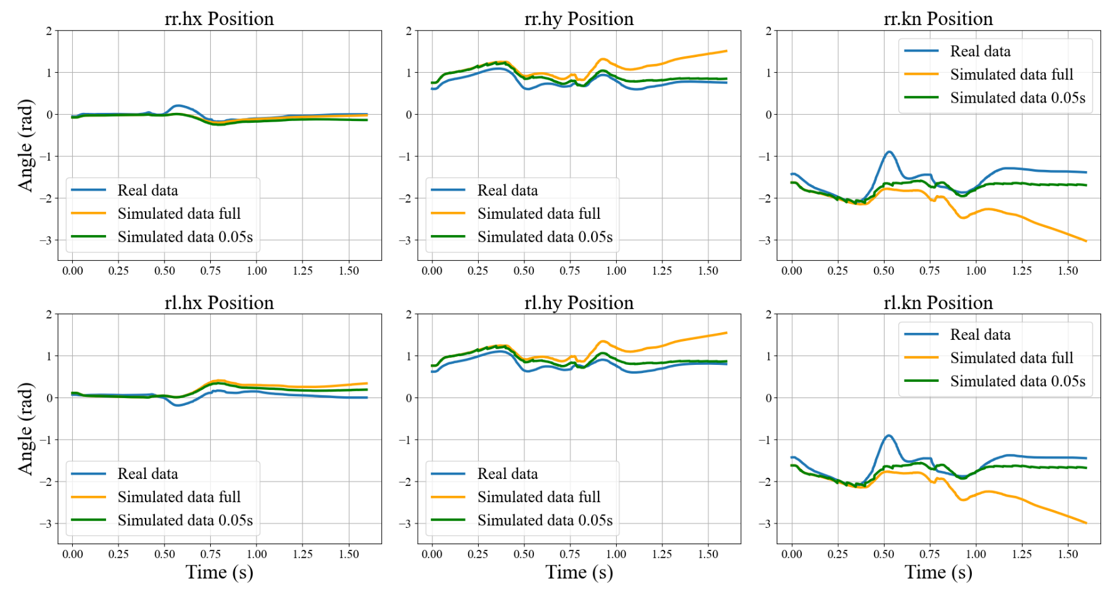
Results – Go1 Real
Motivation
Methodology
Results
Discussion

Slide 19
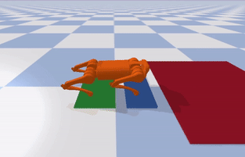
Results – A1 Simulation
Motivation
Methodology
Results
Discussion

Slide 20
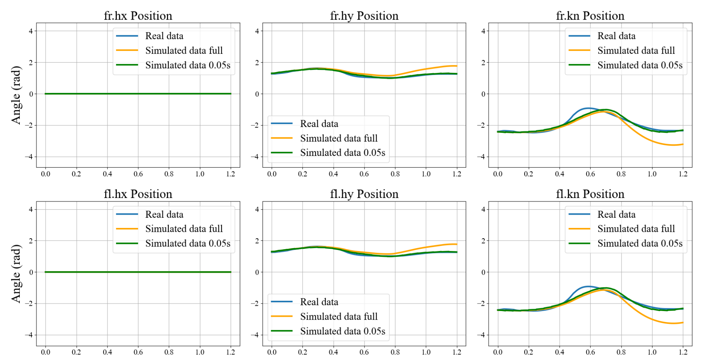
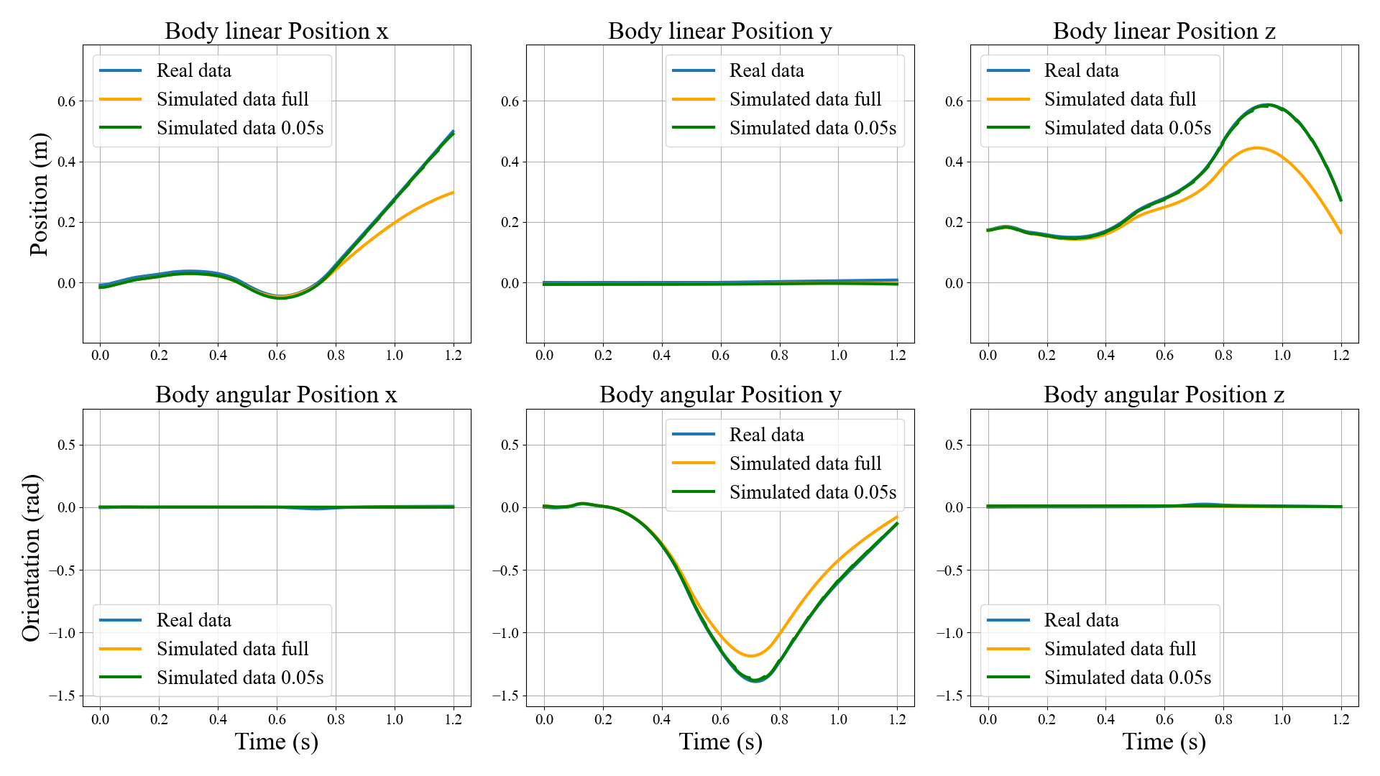
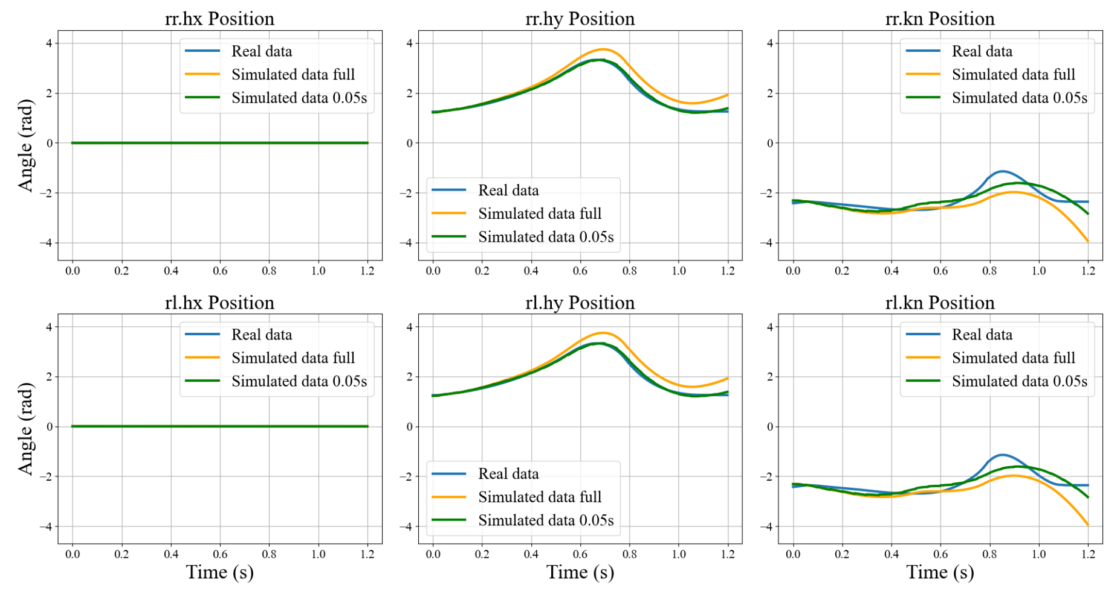
Results – A1 Simulation
Motivation
Methodology
Results
Discussion

Slide 21
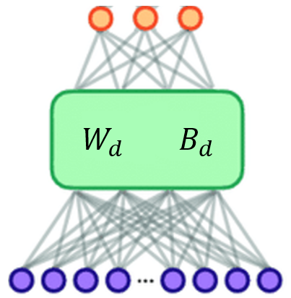
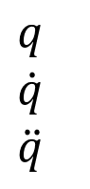
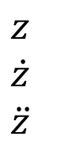
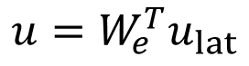
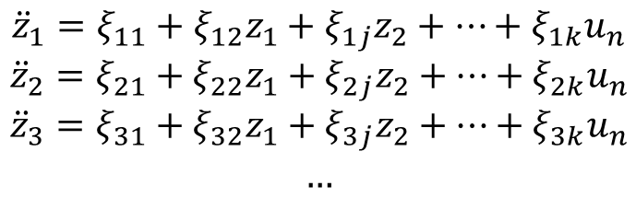
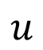
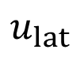
Discussion – Model use
$${\ddot{z}}_{1}=ξ_{11}+ξ_{12}z_{1}+ξ_{1j}z_{2}+…+ξ_{1k}u_{n}$$
$${\ddot{z}}_{2}=ξ_{21}+ξ_{22}z_{1}+ξ_{2j}z_{2}+…+ξ_{2k}u_{n}$$
$${\ddot{z}}_{3}=ξ_{31}+ξ_{32}z_{1}+ξ_{3j}z_{2}+…+ξ_{3k}u_{n}$$
$$…$$
$$z$$
$$\dot{z}$$
$$\ddot{z}$$
$$u_{lat}$$
$$u=W_{e}^{T}u_{lat}$$
$$q$$
$$\dot{q}$$
$$\ddot{q}$$
Real coordinates
$$u$$
Motivation
Methodology
Results
Discussion

Slide 22


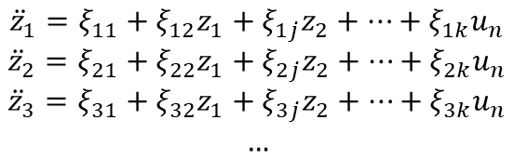
Discussion – Final result
Learning
Interpretable
Reduced-order
Models
for
Jumping Quadrupeds
$${\ddot{z}}_{1}=ξ_{11}+ξ_{12}z_{1}+ξ_{1j}z_{2}+…+ξ_{1k}u_{n}$$
$${\ddot{z}}_{2}=ξ_{21}+ξ_{22}z_{1}+ξ_{2j}z_{2}+…+ξ_{2k}u_{n}$$
$${\ddot{z}}_{3}=ξ_{31}+ξ_{32}z_{1}+ξ_{3j}z_{2}+…+ξ_{3k}u_{n}$$
$$…$$
Motivation
Methodology
Results
Discussion

Slide 23
Thank you for your attention!
Gioele Buriani

Slide 24
Appendix
Related works:
Parameter identification
Gaussian Processes
Methodology:
Dynamic system interpretation
Algorithm contributions
Learning algorithm
SINDy library composition
Transfer learning
Testing method
Results:
Latent dimensionality analysis
Noisy data
4D noisy model
Future works:
Future works
Thesis report:
Introduction, Related Works, Preliminary
Methodology
Experimental Validation
Discussion and conclusion, Future Works, Acknowledgments, References, Appendix

Slide 25
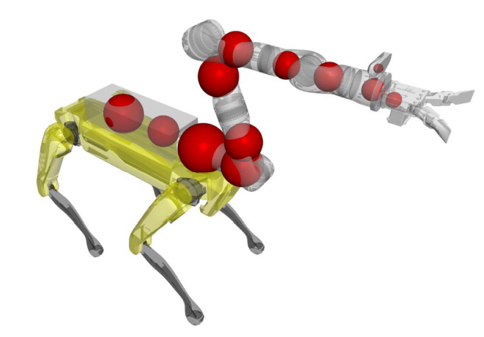
Related works
Go Fetch! - Dynamic Grasps using Boston Dynamics Spot with External Robotic Arm S. Zimmermann, R. Poranne, S. Coros - 2021
Method: Parameter identification
Advantages: - Simple to implement
Disadvantages: - Pre-defined general dynamics - Lacks accuracy for more complex scenarios

Slide 26
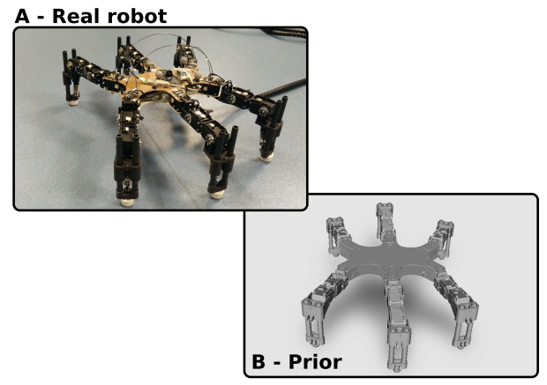
Related works
Using Parameterized Black-Box Priors to Scale Up Model-Based Policy Search for Robotics Konstantinos Chatzilygeroudis, Jean-Baptiste Mouret - 2018
Method: Gaussian Processes
Advantages: - Fast learning - Model contains uncertainties estimation
Disadvantages: - Does not scale well with dimensionality - Lacks interpretability

Slide 27
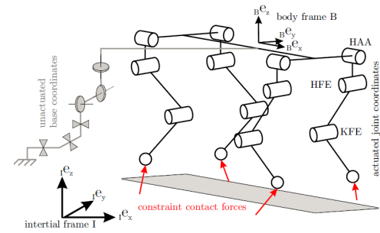
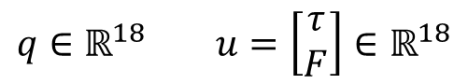
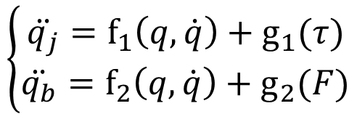


Methodology – Dynamic system interpretation
Approximation:
$$F=\left[\begin{aligned}\sum_{k=1}^{4}{\left(J_{k}^{−T}τ_{k}\right)c_{k}} \\ \sum_{k=1}^{4}{\left(J_{k}^{−T}τ_{k}×x_{k}\right)c_{k}}\end{aligned}\right]$$
State: $$q=\left[\begin{aligned}q_{j} \\ q_{b}\end{aligned}\right]$$
Dynamics equation: $$M\left(q\right)\ddot{q}+h\left(q,\dot{q}\right)=S^{T}τ+J_{C}^{T}\left(q\right)λ$$
$$\left\{\begin{aligned}\ddot{q_{j}}={\text{f}}_{1}\left(q,\dot{q}\right)+{\text{g}}_{1}(τ) \\ \ddot{q_{b}}={\text{f}}_{2}\left(q,\dot{q}\right)+{\text{g}}_{2}(F)\end{aligned}\right.$$
$$q∈ℝ^{18} u=\left[\begin{aligned}τ \\ F\end{aligned}\right]∈ℝ^{18}$$

Slide 28



Methodology – Algorithm contributions
Data-driven discovery of coordinates and governing equations
K Champion, B Lusch, JN Kutz, SL Brunton
Main contributions:
Linear autoencoder
Second-order model
Latent input
$${\ddot{z}}_{pred}=Θ\left(z,\dot{z},u_{lat}\right)Ξ$$

Slide 29













Methodology – Learning algorithm
$$\dot{q}$$
$$\ddot{q}$$
$$q$$
$$u$$
$$z=W_{e}q+B_{e}$$
$$q_{dec}=W_{d}z+B_{d}$$
$${\ddot{x}}_{pred}=W_{d}{\ddot{z}}_{pred}$$
$$\dot{z}=W_{e}\dot{q}$$
$$\ddot{z}=W_{e}\ddot{q}$$
$$u_{lat}=W_{e}^{−T}u$$
$${\ddot{q}}_{pred}$$
$${\ddot{z}}_{pred}$$
Losses:
- Autoencoder loss
- Sindy loss
$$z$$
$$q_{dec}$$
$$\dot{z}$$
$$\ddot{z}$$
$$u_{lat}$$
- Sindy decoded loss
- Regularization loss
$${\ddot{z}}_{pred}=Θ\left(z,\dot{z},u_{lat}\right)Ξ$$

Slide 30


Methodology – SINDy library composition
Constant term
Linear terms (first order polynomials)
Trigonometric terms
Input terms
With $n$ state variables:
$1+7n$ library terms
$n+7n^{2}$ total SINDy coeffients
$$1$$
$$z_{1},z_{2},…,z_{n}$$
$${\dot{z}}_{1},{\dot{z}}_{2},…,{\dot{z}}_{n}$$
$$\sin\left(z_{1}\right),\sin\left(z_{2}\right),…,\sin\left(z_{n}\right)$$
$$\cos\left(z_{1}\right),\cos\left(z_{2}\right),…,\cos\left(z_{n}\right)$$
$$\sin\left({\dot{z}}_{1}\right),\sin\left({\dot{z}}_{2}\right),…,\sin\left({\dot{z}}_{n}\right)$$
$$\cos\left({\dot{z}}_{1}\right),\cos\left({\dot{z}}_{2}\right),…,\cos\left({\dot{z}}_{n}\right)$$
$$u_{1},u_{2},…,u_{n}$$

Slide 31



Methodology – Transfer learning
Contact
model
Flight
model

Slide 32

Methodology – Testing method
Testing method
Initial state $\left[q_{0},{\dot{q}}_{0}\right]$ and inputs $u$ transformed into $\left[z_{0},{\dot{z}}_{0}\right]$ and $u_{lat}$
${\ddot{z}}_{pred}$ calculated with trained latent space model $M$: ${\ddot{z}}_{pred}=M(z,\dot{z},u_{lat})$
Real positions calculated as: $q_{pred}=W_{d}z_{pred}+B_{d}$
Possibility to simulate for smaller time batches

Slide 33




Results – Latent dimensionality analysis

Slide 34

Results – Noisy data
Noisy dataset:
Gaussian noise on the initial configuration
Gaussian noise on the state readings
External disturbance force applied to the robot’s CoM
Learned with:
4D latent space model

Slide 35

Results – 4D noisy model
Model for the contact phase trained on the noisy simulated Go1 data
$\left\{\begin{aligned}{\ddot{z}}_{1}=−0.11−1.00{\dot{z}}_{1}−0.94{\dot{z}}_{2}−1.16\sin\left({\dot{z}}_{1}\right)−1.23\sin\left({\dot{z}}_{2}\right)+0.06u_{1}−0.04u_{2}+0.07u_{3} \\ {\ddot{z}}_{2}=0.16−16.42z_{2}−14.32z_{3}+8.05{\dot{z}}_{1}+5.44{\dot{z}}_{2}−2.89{\dot{z}}_{3}−16.41\sin\left(z_{2}\right)−14.32\sin\left(z_{3}\right)+ \\ +8.27\sin\left({\dot{z}}_{1}\right)+3.89\sin\left({\dot{z}}_{2}\right)−3.05\sin\left({\dot{z}}_{3}\right)+0.01u_{2}+0.17u_{3}+0.13u_{4} \\ {\ddot{z}}_{3}=0.04{\dot{z}}_{2}−0.55{\dot{z}}_{3}+0.01u_{2}+0.17u_{3} \\ {\ddot{z}}_{4}=0.25{\dot{z}}_{1} \end{aligned}\right.$

Slide 36




Future works
Nonlinear autoencoders
$$1$$
$$z_{1},z_{2},…,z_{m}$$
$${\dot{z}}_{1},{\dot{z}}_{2},…,{\dot{z}}_{m}$$
$$\sin\left(z_{1}\right),\sin\left(z_{2}\right),…,\sin\left(z_{m}\right)$$
$$\cos\left(z_{1}\right),\cos\left(z_{2}\right),…,\cos\left(z_{m}\right)$$
$$\sin\left({\dot{z}}_{1}\right),\sin\left({\dot{z}}_{2}\right),…,\sin\left({\dot{z}}_{m}\right)$$
$$\cos\left({\dot{z}}_{1}\right),\cos\left({\dot{z}}_{2}\right),…,\cos\left({\dot{z}}_{m}\right)$$
SINDy library improvement
Backpropagation Through Time
Application to different quadruped tasks

Slide 37



Slide 38



Slide 39



Slide 40



Slide 41



Slide 42



